Slide 1
Problems

Slide 2
Types of Computer
There are many different types of computer:
general purpose - PCs, Laptops etc
specialised - servers, routers,microcontrollers

Slide 3
Functions
In general computers can do four things:
Input (accepts data)
Processing (processes data)
Output (produces output)
Storage (save results)

Slide 4
Example
Using one specific computing device (i.e. your smart phone) give examples of these four functions in action:
Type of Computer: iPod touch
Receives information from touch screen/camera/microphone
Outputs information on screen in desired format
Music storage

Slide 5
Why Computers?
What advantages/disadvantages are there when using a computer for a task, compared to a human?
(list as many reasons as you can)
Computers can perform accurate calculations relatively quickly which humans would find difficult or impossible to do

Slide 6
List some Apps that are used for...
Storing of information
Notes
Music
Memos

Slide 7
List some Apps that are used for...
Retrieving information
Google Chrome

Slide 8
List some Apps that are used for...
Sending or communicating information
Facebook Messenger
Skype
Viber

Slide 9
List some Apps that are used for...
Modifying or transforming information.
Microsoft Word

Slide 10
Hardware/Software
What is the difference between hardware and software?
Hardware: any physical device that makes up the computer
Software: the code used to run programs etc. on the computer

Slide 11
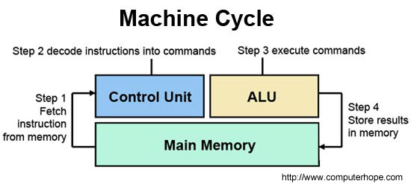
What are the following for?
The CPU (Central Processing Unit) comprises an arithmetic logic unit (ALU), which performs arithmetic/logic operations, and a control unit (CU), which directs all of the operations of the CPU
GPU

Slide 12
What are the following for?
The CPU (Central Processing Unit) comprises an arithmetic logic unit (ALU), which performs arithmetic/logic operations, and a control unit (CU), which directs all of the operations of the CPU
The speed of a CPU can be indicated by its clock rate, i.e. the speed at which it executes instructions. Clock rates are measured in MHz (megahertz) or GHz (gigahertz)

Slide 13
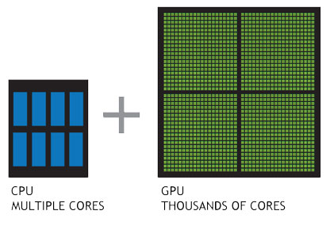
The GPU (Graphics Processing Unit) or VPU (Visual Processing Unit) was first developed by NVIDIA. GPUs are specially designed to create (often 3D) images, a very intensive task which would put a lot of strain on the CPU.
NVIDIA’s GeForce 256 GPU is capable of billions of calculations per second
image: www.nvidia.com

Slide 14
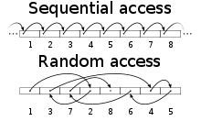
RAM (Random-Access Memory) is a form of computer data storage whereby data can be stored and accessed randomly (in comparison to CDs or Hard Drives where data is accessed sequentially, i.e. in a premediated, ordered sequence). Data is therefore able to be accessed more quickly.
RAM is useful for running applications, where data must be accessed quickly.
RAM is an example of volatile memory, i.e. data is lost when the device is shut down. ROM (Read-Only Memory) is non-volatile and information is saved after shutting off the device.
image: en.wikipedia.org

Slide 15
The Motherboard

Slide 16
Hard drive

Slide 17
Software I
What is an operating system (OS) ? List some variants.

Slide 18
Software II
In relation to computer software, what are drivers?

Slide 19
Networks
What do computer networks allow us to do?
What is the difference between the world wide web (www) and the internet?

Slide 20
Network Topologies
What do the following network configurations look like?
Ring
Star
Bus
Which configuration do you think this lab uses?

Slide 21
Acronyms
Explain:
LAN
WAN
MAN

Slide 22
Protocols
A protocol is simply an agreed way of doing things. For instance, social protocol dictates that if someone greets you with “Dia duit” you reply with “Dia is Muire duit”
Computers have similar - albeit more robust - communication protocols.

Slide 23
What are these Protocols for?
SMTP/POP3
FTP
TCP/IP

